Slide 1

WIGOS Measurements
Pre INFCOM-3 Information Session
(25 March - 5 April 2024)
Jane Warne/SC-MINT Chair &
PW Chan/SC-MINT co-vice-chair
26 March 2024

Slide 2

Content
Doc 8.2(1) - Guide to Instruments and Methods of Observation (WMO-No. 8)
Doc. 8.2(2) - Evolvement of the operational measurement uncertainty requirements
Doc 8.2(3) - Guide to Operational Weather Radar Best Practices (WMO-No. 1257)
Doc 8.2(4) - Update of the Guide to Hydrological Practices (WMO-No. 168)
Doc 8.2(5) - Guidelines for Radiometer Comparisons
Doc 8.2(6) - Future instrument intercomparisons
Doc 8.2(7) – Upper-air instrument intercomparison follow-up
Introduction to SC-MINT
How to access WMO Guides
Nomination of experts

Slide 3
8.2(1) Update of the Guide to Instruments and Methods of Observation (WMO-No. 8)
Recognized as the main source of information used by Members to standardize instrument performances and ensure the quality of observations,
Constantly reviewed and regularly updated by the relevant expert teams of SC-MINT considering the developments of new methods, techniques, and systems in the field of instrumentation, measurement, and calibration

Slide 4
8.2(1) Update of the Guide to Instruments and Methods of Observation (WMO-No. 8)
Update process:
Proposals for updates prepared by relevant Expert Teams, and reviewed by SC-MINT Editorial Board.
All proposals for the update of the chapters of the Guide were posted on the WMO website for Member review. Circular letter issued on 23 February 2024 calling for review by Members.
The feedback from the Members is being considered either for the Provisional 2024Ed to be submitted to INFCOM-3 or for later update of the Guide in the future workplan of the commission.

Slide 5
8.2(1) Update of the Guide to Instruments and Methods of Observation (WMO-No. 8)
Chapters that were updated:
Major revision of Volume I, Chapter 6 “Measurement of precipitation”
Partial revision of Volume I, Chapter 7 “Measurement of radiation”
Minor revision of Volume II, Chapter 1 “General”
New chapter on the measurement of permafrost, Chapter 4 in Volume II
Minor revision of Volume III, Chapter 5 “Special profiling techniques for the boundary layer and the troposphere”
Proposed decision: Adopt provisional 2024 Edition of WMO-No. 8
Will be submitted to INFCOM-3 as non-controversial document

Slide 6
8.2(1) - Volume I, Chapter 6 “Measurement of precipitation”
Chapter restructured by removing or renaming some sections, and adding new sections
Updates made by deleting outdated information
Part of the information from removed sections was moved to the new sections
New sections in the chapter:
Weighing (Automated) gauges
Non-Catching Technologies (optical/impact/radar instruments)
Challenges on the Measurement of Precipitation
Transfer Functions
Precipitation Data Quality Control (automated gauges)

Slide 7
8.2(1) - Volume I, Chapter 7 “Measurement of radiation”
Existing structure kept by making minor renaming in some sections
Partial updates made in some sections and relevant tables
Calibration of pyrheliometers
Calibration of pyrgeometers
References
New sections in the chapter:
Standardization of terrestrial radiation measurements
Annex 7.D. Guidelines for Radiometer Comparisons

Slide 8
8.2(1)/Volume II, Chapter 1 “General”
Authors and reviewers added at the beginning of the chapter
Existing structure kept by making minor renaming and reordering sections
Minor updates made in some sections and relevant tables
8.2(1)/Volume II, Chapter 4 “Measurement of permafrost”
Authors and reviewers acknowledged at the beginning of the chapter
Structured with sections:
General
Measurements of permafrost temperature
Measurements of Active Layer Thickness
Measurements of Rock Glacier Velocity
Supplementary Measurements
References
8.2(1)/Volume III, Chapter 5 “Special profiling techniques for the boundary layer and the troposphere”
Minor update in the section for Wind Profiler Radars

Slide 9
8.2(1) - Comments/suggestions from Members and HMEI for WMO-No. 8
Comments received from:
China
Germany
Guinee
Hong Kong, China
Italy
Japan
Republic of Korea
UK
HMEI (OTT, WindBorne Systems)
Comments are being reviewed/addressed by relevant Expert Teams and Editorial Board.

Slide 10
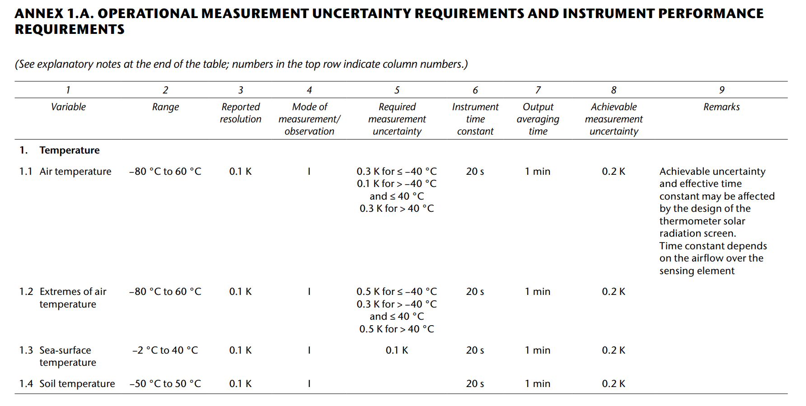
8.2(2) Evolvement of the operational measurement uncertainty requirements (WMO-No. 8, Vol.I,Ch1,Annex 1A)
User requirements – now provided in OSCAR/Requirements
Typical operational performances
This table was frequently wrongly used for procurements.
Proposal is to replace it with something more suitable.

Slide 11
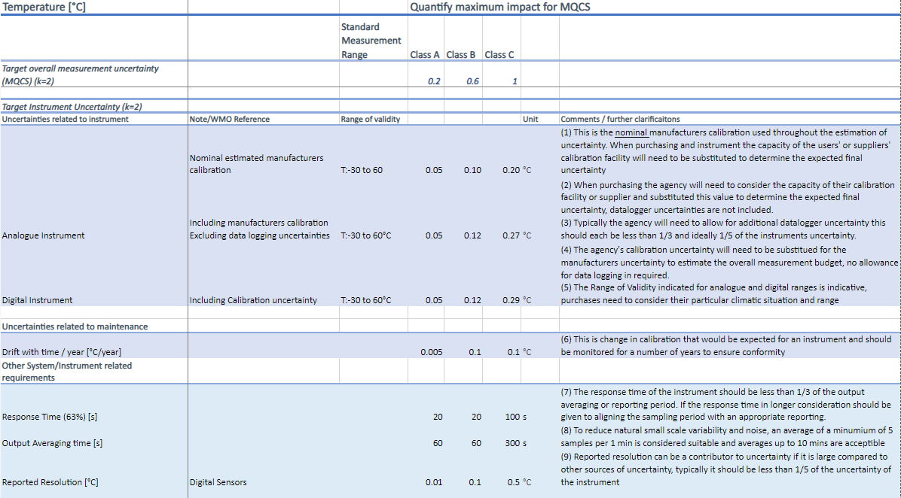
8.2(2) Evolvement of the operational measurement uncertainty requirements (WMO-No. 8, Vol.I,Ch1,Annex 1A)
Sample of new Annex 1A Guidance

Slide 12
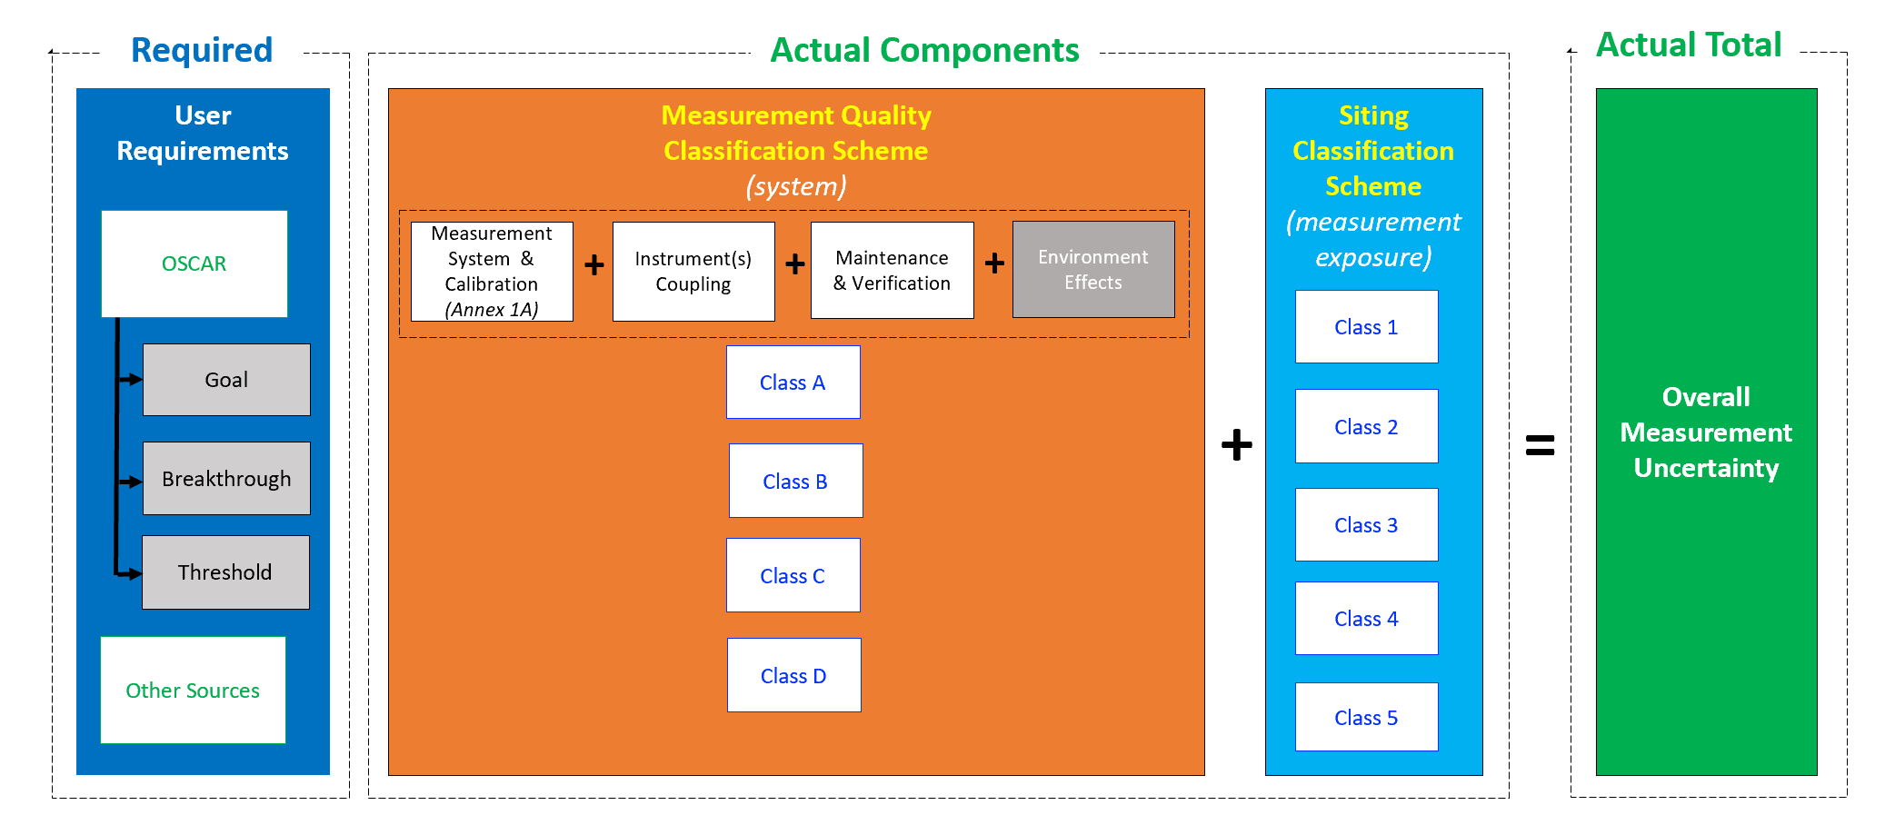
8.2(2) Evolvement of the operational measurement uncertainty requirements (WMO-No. 8, Vol.I,Ch1,Annex 1A)

Slide 13
8.2(2) Evolvement of the operational measurement uncertainty requirements (WMO-No. 8, Vol.I,Ch1,Annex 1A)
Background:
Annex 1A is providing information on instrument performance. Widely used by Members in procurement processes.
SC-MINT ET on Measurement Uncertainty initiated update of the Annex 1.A of WMO-No. 8.
Proposal is to develop a comprehensive scheme that will provide overview of the relevant uncertainty contributions (that are missing in the current annex) and ensure that the overall measurement uncertainty requirements explicitly documented and aligned with the Measurement Quality Classifications.
Need to find a modern place for “a comprehensive scheme” that should allow easy access and agile maintenance.
Anticipated solution can involve a new module within the OSCAR family that could be dedicated to the surface-based measurement capabilities. Being placed within OSCAR, the measurement capabilities could easily serve as inputs to the gap analyses performed with the WIGOS Rolling Review of Requirements.

Slide 14
8.2(2) Evolvement of the operational measurement uncertainty requirements (WMO-No. 8, Vol.I,Ch1,Annex 1A)
Proposed decision:
To endorse the proposal for the evolvement of the existing Operational measurement uncertainty requirements and instrument performance requirements (WMO-No. 8, Vol I, CH 1, Annex 1.A) into a comprehensive scheme that will be aligned with the Measurement Quality Classifications for Surface Observing Stations on Land, and will ensure unambiguous and interpretable linkages to the OSCAR/Requirements;
To task SC-MINT to continue the evolvement as proposed, and lead the development of an appropriate tool, possibly within OSCAR database, to accommodate the new scheme.

Slide 15
8.2(3) Update of the Guide to Operational Weather Radar Best Practices (WMO-No. 1257)
Background:
The Guide to Operational Weather Radar Best Practices (WMO-No. 1257) is being developed by the INFCOM Joint Expert Team on Operational Weather Radars (JET-OWR) with the aim to provide an important source of guidance material on various aspects of the operational weather radars.
It also provides complementary and supportive guidance on radar-related material already available in other WMO guides, such as in WMO-No. 8.
Eight volumes:
  I. “Weather Radar Network Program Design”
  II. “Weather Radar Technology”
  III. “Weather Radar Procurement”
  IV. “Weather Radar Siting, Configuration, and Scan Strategies”
  V. “Weather Radar Calibration, Monitoring, and Maintenance”
  VI. “Weather Radar Data Processing “
  VII. “Weather Radar Data Representation and International Exchange.”
  VIII. “Operational Weather Radar Glossary of Terminology”

Slide 16
8.2(3) Update of the Guide to Operational Weather Radar Best Practices (WMO-No. 1257)
Volumes I, II, III and VII were approved by EC-76 and have been published.
New Volumes that were developed for the approval of INFCOM-3:
  Vol. IV “Weather Radar Siting, Configuration, and Scan Strategies”
  Vol. V “Weather Radar Calibration, Monitoring, and Maintenance”
  Vol. VI “Weather Radar Data Processing”
Proposed decision: Adopt provisional 2024 Edition of WMO-No.1257
Will be submitted to INFCOM-3 as a non-controversial document

Slide 17
8.2(3) Update of the Guide to Operational Weather Radar Best Practices (WMO-No. 1257)
Vol. IV “Weather Radar Siting, Configuration, and Scan Strategies”
  Target audience: Decision-makers, network program managers and practitioners.
  Covers topics, such as:
    Selecting a good radar site
    Determining site infrastructure
    Networking for remote control and data transfer.
    Complying with relevant RF regulations.
    Ensuring microwave radiation safety close to the radar.
    Optimizing radar parameters for optimal radar operations
    Setting up a data archival strategy

Slide 18
8.2(3) Update of the Guide to Operational Weather Radar Best Practices (WMO-No. 1257)
Vol. V “Weather Radar Calibration, Monitoring, and Maintenance”
  Target audience: Operations, monitoring and maintenance practitioners and planners
  Covers topics, such as:
    Radar hardware calibration
    Methods for radar adjustment and monitoring
    Preventative and corrective radar maintenance

Slide 19
8.2(3) Update of the Guide to Operational Weather Radar Best Practices (WMO-No. 1257)
Vol. VI “Weather Radar Data Processing”
  Target audience: Radar operators, radar application developers, radar data product users.
  Provides detailed guidance on various processing methods to make radar products from raw data observed by weather radars.
    Radar data quality control
    Quantitative Precipitation Estimation (QPE)
    Weather radar compositing
    Various other radar products

Slide 20
8.2(3) Update of the Guide to Operational Weather Radar Best Practices (WMO-No. 1257)
Update process (similar to that of WMO-No. 8):
Proposals for updates prepared by JET-OWR and reviewed by SC-MINT Editorial Board.
All new volumes of the Guide were posted on the WMO website for Member review. Circular letter issued on 23 February 2024 calling for review.
The feedback from the Members is being considered either for the Provisional 2024Ed to be submitted to INFCOM-3 or for later update of the Guide in the future workplan of the commission.

Slide 21
8.2(4) Update of the Guide to Hydrological Practices (WMO-No. 168)
The Guide is recognized by Members as the main source of information on recommended practices
Update process:
Minor update: New section on “Image-based methods for discharge measurement”
Proposals developed by JET-HYDMON and SC-HYD, and reviewed by SC-MINT Project X and Editorial Board.
Proposed decision: Adopt proposed update
Will be submitted to INFCOM-3 as non-controversial document

Slide 22
8.2(5) Guidelines for Radiometer Comparisons
Background:
WMO defined the radiometric references to which Members’ instrument are traceable.
WMO organizes regular radiometer comparisons, and to ensure the stability of those references.
SC-MINT Expert Team on Radiation References developed guidelines to foster comparability and transparency of the procedure followed during radiometer comparisons (duration, environmental conditions, sampling, metadata, management of intercomparison database). Should enable different analysis methodologies.
Those guidelines were included in the update of the Guide to Instruments and Methods of Observation (WMO-No. 8).
Particularly important in the context of an expected change of radiation references
Proposed decision:
Recommends the Executive Council to request radiation centres, especially the World Radiation Centre and Regional Radiation Centres, to follow these guidelines when organizing next radiometer comparisons.
Requests SC-MINT to promote use of those guidelines in future intercomparison

Slide 23
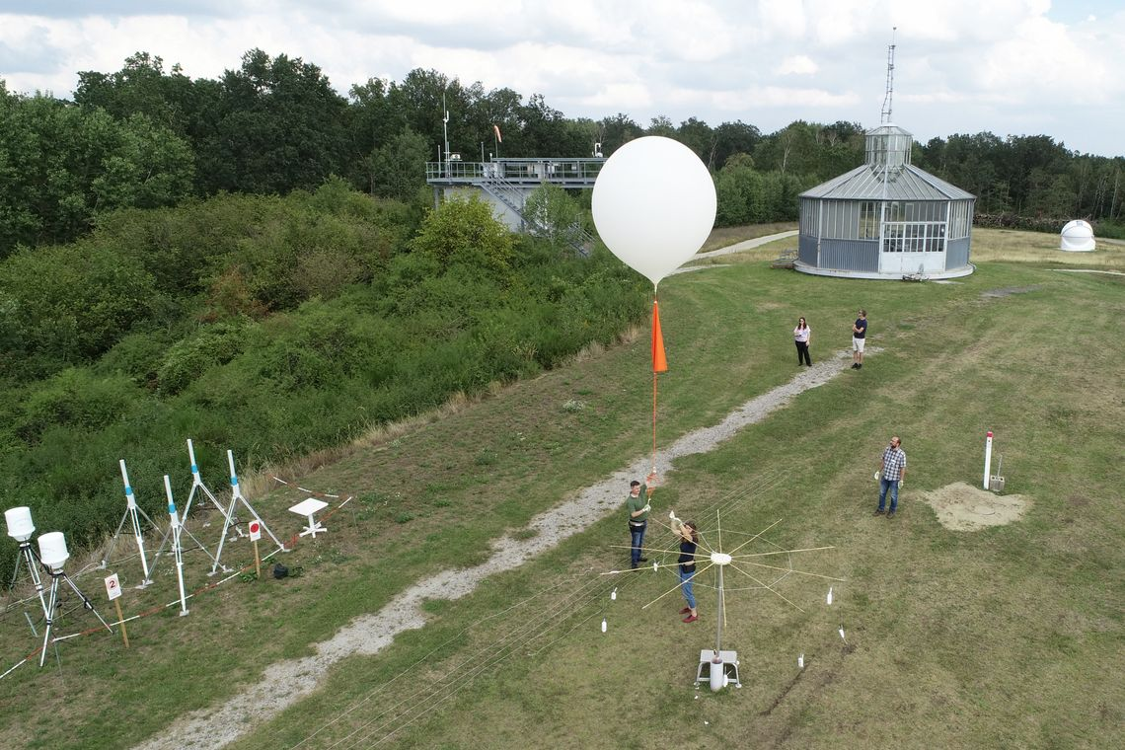
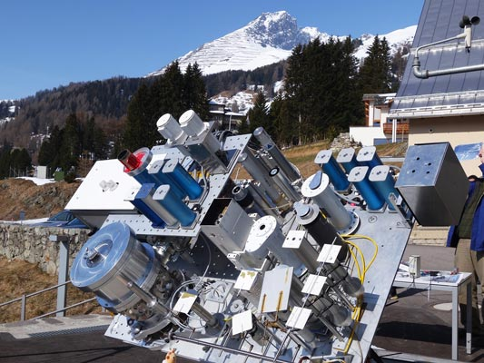
8.2(6) Future instrument intercomparisons
Background:
Instrument intercomparisons are important to assess performance of instruments
Several instrument intercomparisons were proposed by experts.
Global instrument intercomparisons require large amounts of resources. Very challenging to organize several intercomparisons at the same time.
Need for prioritization based on relevance of topic, ability of potential leads, and availability of resources.

Slide 24
8.2(6) Future instrument intercomparisons
Call to Members:
To share procedures related to testing of Automatic Weather Stations (AWSs), in particular of all-in-one AWSs
To conduct experiments related to the implementation of the Siting Classification for Surface Observing Stations on Land (quantify the impact of obstacles)
To publish results of instrument intercomparisons performed at national level
To consider hosting future WMO instrument intercomparisons
Requests SC-MINT:
To reviewing the detailed plans/concept notes for instrument intercomparisons
To prioritize intercomparisons
To develop guidelines for the intercomparison of all-in-one AWSs that could be later applied by Members in conducting a distributed intercomparison of all-in-one AWSs

Slide 25

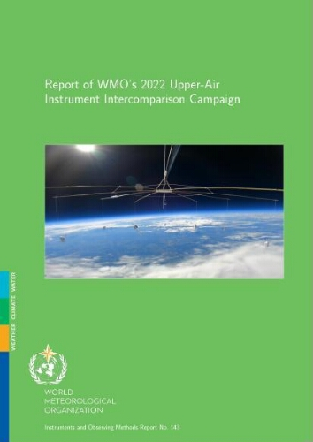
8.2(7) Upper-air instrument intercomparison follow-up
Background:
Report of WMO 2022 Upper-Air Instrument Intercomparison Campaign has just been published.
Methodology:
  Radiosonde and remote-sensing instruments
  Included a laboratory and a field phase for radiosondes
  Independent radiosonde operators
  Use of GRUAN data products (well characterized uncertainties) as reference
  Performance assessed against user uncertainty requirements published in OSCAR/requirements for several application areas
  Transparent methodology (code published)
Database available for further studies

Slide 26
8.2(7) Upper-air instrument intercomparison follow-up
Background:
Report of WMO 2022 Upper-Air Instrument Intercomparison Campaign has just been published.
The report includes several recommendations to WMO, Members and manufacturers.
Invites instrument manufacturers to follow-up recommendations for improvements of upper-air observing systems as provided in the intercomparison report (e.g. calibration of humidity sensors, time lag behavior of humidity at low temperatures between -40°C and -85°C), and to continue their efforts to reduce the environmental impact of those systems,
Urges SC-ON to ensure that the OSCAR requirements include clear references on their justification and on how they were derived

Slide 27
8.2(7) Upper-air instrument intercomparison follow-up
Proposed decisions:
Request INFCOM:
to update WMO-No. 8 based on intercomparison findings
to facilitate the access to existing radiosonde codes and attribution of codes to newly developed radiosonde systems
Invites Measurement Lead Centres, in collaboration with INFCOM:
To help in verifying the correctness of BUFR data generated by new radiosonde systems
To consider hosting future upper-air instrument intercomparisons, building on the experience gained through this intercomparison

Slide 28
Standing Committee on Measurements, Instrumentation and Traceability (SC-MINT)
In collaboration with other Standing Committees, Research Board, and partners:
Provide guidance to support changing user requirements;
Promote innovation and the application of emerging technologies, techniques and integrated solutions in measurement;
Develop, provide and maintain effective standards, other regulatory and guidance material related to instrumentation and measurement practices;
Develop, establish, publish, maintain and provide guidance on the traceability of measurement quality to international standards, also quantifying the uncertainties of the measurements;
Coordinate and conduct instrument intercomparisons;
Develop, update and promote education and training material on measurements, instrumentation and traceability;
Support capacity development and community of practices especially for the transition from manual to automatic measurements;
Promote and assess the operations of WMO designated measurement-related centres;

Slide 29
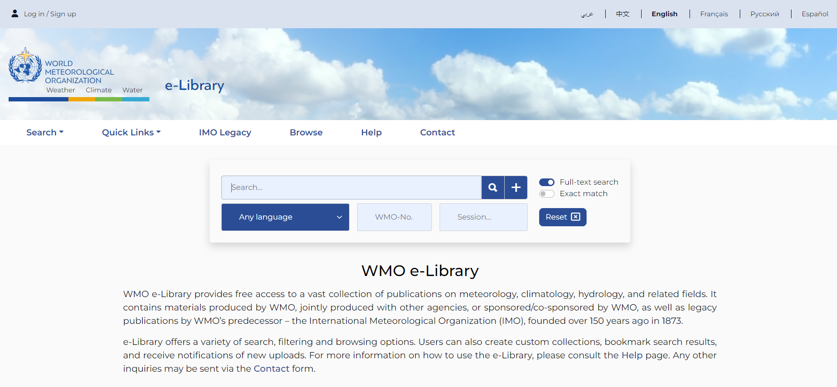
How to access WMO Guides
All regulatory and guidance material is available at the e-library of WMO (https://library.wmo.int/)

Slide 30
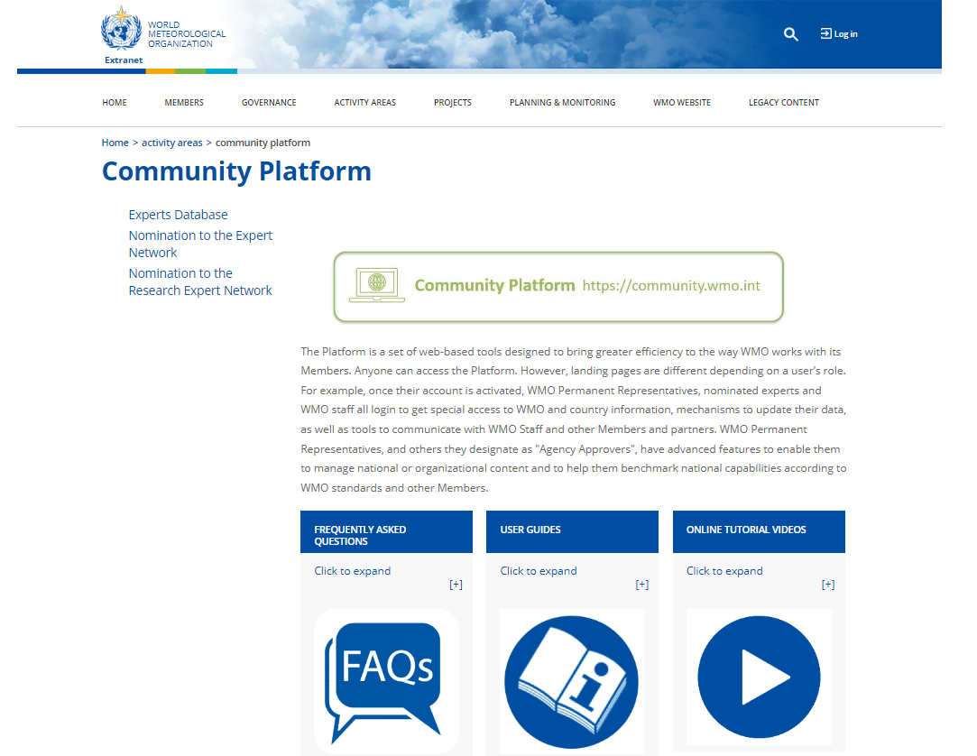
Nomination of Experts for SCs and ETs/TTs
https://community.wmo.int/activity-areas/community-platform
A circular letter was sent to all Members for nomination of experts on 16 February 2024
Letter in Arabic
Letter in Chinese
Letter in English
Letter in French
Letter in Russian
Letter in Spanish

Slide 31
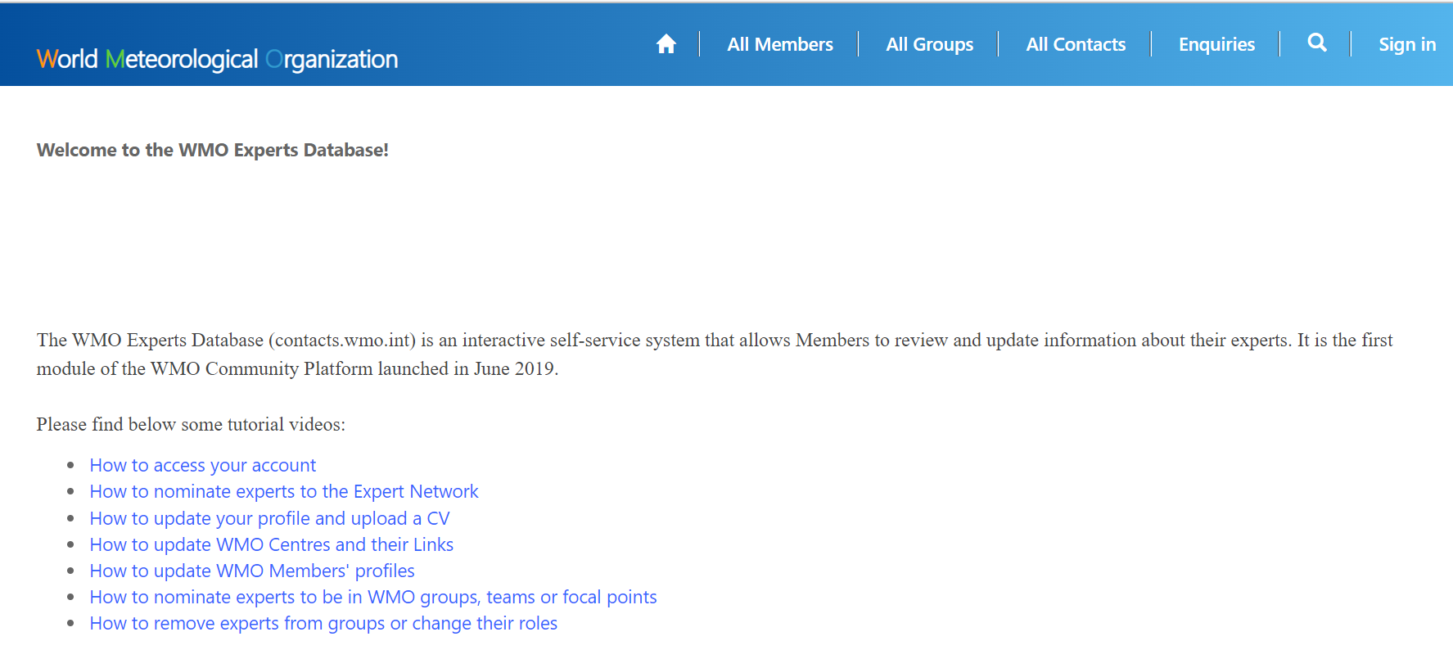
Nomination of Experts for SCs and ETs/TTs
https://contacts.wmo.int/

Slide 32
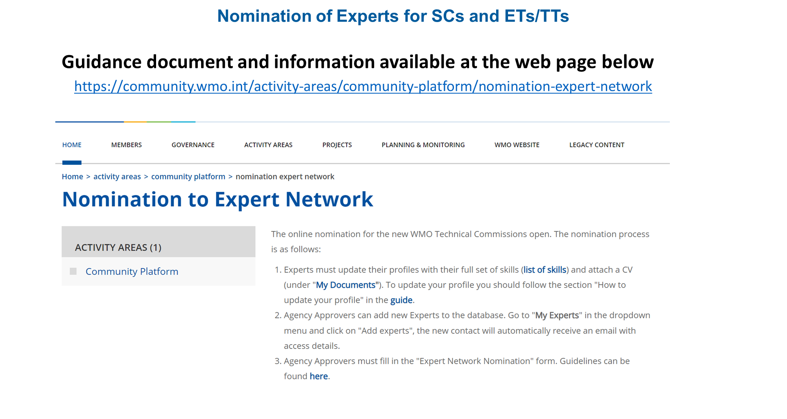

Slide 33
Thank you.
^{wmo.int}

